Slide 1
Walmart sales analysis sql project
Submitted By: Ashish Kumar Jha

Slide 2
TASK 1 - Top Branch by Sales Growth Rate
Use CTE - Extract Month from Date, SUM to get Monthly Total Sales
Use LAG - Compare Total Sales per Month with Previous Month to find Growth Rate.
Group Growth Rate by Branch with Order DESC and Limit 1 to get Branch with Highest Growth Rate
ANSWER: Branch A with 26.12% Growth Rate

Slide 3
TASK 1 – SQL CODE
SELECT Branch,
ROUND(MAX(
CASE
WHEN PreviousMonthSales IS NOT NULL AND PreviousMonthSales > 0 THEN
(TotalSales - PreviousMonthSales) * 100.0 / PreviousMonthSales
ELSE 0
END
), 2) AS MaxGrowthRate
FROM
SalesGrowth
GROUP BY
Branch
ORDER BY
MaxGrowthRate DESC
LIMIT 1;
WITH SalesGrowth AS (
SELECT
Branch,
DATE_FORMAT(STR_TO_DATE(Date, '%d-%m-%Y'), '%Y-%m') AS Month,
SUM(Total) AS TotalSales,
LAG(SUM(Total)) OVER (PARTITION BY Branch ORDER BY DATE_FORMAT(STR_TO_DATE(Date, '%d-%m-%Y'), '%Y-%m')) AS PreviousMonthSales
FROM
walmartsales
GROUP BY
Branch, DATE_FORMAT(STR_TO_DATE(Date, '%d-%m-%Y'), '%Y-%m’)
)

Slide 4
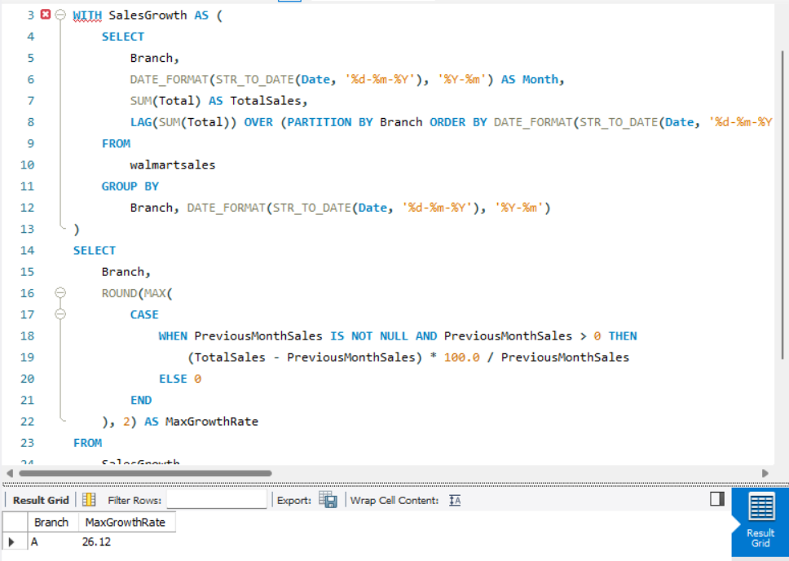
Task 1 - Output

Slide 5
TASK 2 - Most Profitable Product Line for Each Branch
Use CTE: Rank product lines within each branch based on gross income in descending order using the RANK() function.
Filter Top Product Line: Select only the product line with Rank = 1 for each branch from the CTE.
Output Results: Display the branch, product line, and gross income for the most profitable product line in each branch.
ANSWER: Branch A – Fashion Accessories - 49.49 Profit
Branch B – Home & Lifestyle – 48.69 Profit
Branch C – Fashion Accessories - 49.65 Profit

Slide 6
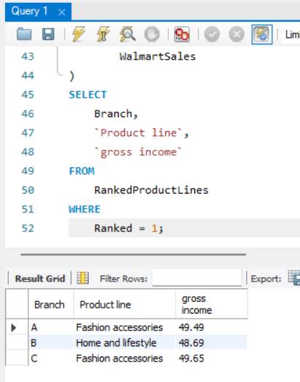
TASK 2 – SQL CODE
WITH RankedProductLines AS (
SELECT Branch, `Product line`, `gross income`,
RANK() OVER (PARTITION BY Branch ORDER BY `gross income` DESC) AS Ranked
FROM
WalmartSales
)
SELECT
Branch, `Product line`, `gross income`
FROM
RankedProductLines
WHERE
Ranked = 1;

Slide 7
TASK 3 - Customer Segmentation Based on Spending
Use CTE: Calculate total purchase amount (Total_Spent) for each customer by grouping data using Customer ID and Customer type.
Use CASE statement: Classify customers into High, Medium, and Low spenders based on their total spending thresholds.
Display the customer ID, type, total spending, and spending tier, sorted by Customer ID in Asc order.

Slide 8
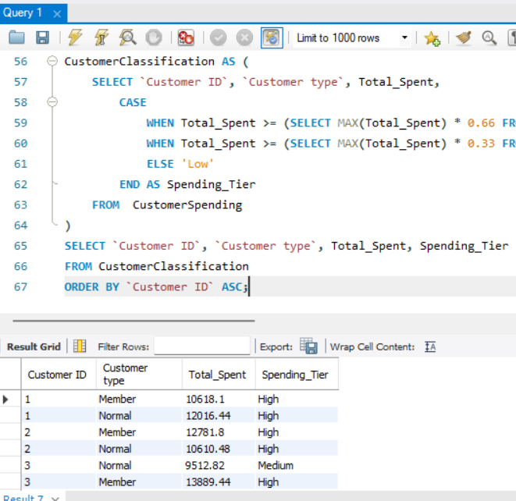
TASK 3 – SQL CODE
FROM CustomerSpending
)
SELECT `Customer ID`, `Customer type`, Total_Spent, Spending_Tier
FROM CustomerClassification
ORDER BY `Customer ID` ASC;
WITH CustomerSpending AS (
SELECT `Customer ID`, `Customer type`, ROUND(SUM(Total),2) AS Total_Spent
FROM WalmartSales
GROUP BY `Customer ID`, `Customer type`
),
CustomerClassification AS (
SELECT `Customer ID`, `Customer type`, Total_Spent,
CASE
WHEN Total_Spent >= (SELECT MAX(Total_Spent) * 0.66 FROM CustomerSpending) THEN 'High'
WHEN Total_Spent >= (SELECT MAX(Total_Spent) * 0.33 FROM CustomerSpending) THEN 'Medium'
ELSE 'Low'
END AS Spending_Tier

Slide 9
TASK 4 - Detecting Anomalies in Sales Transactions
Calculate the Average and Standard Deviation of Total
Define Anomaly Thresholds for High and Low values as par with Average and STD Dev formula
Flag Transactions Outside the Thresholds 812 and 85 and display results

Slide 10
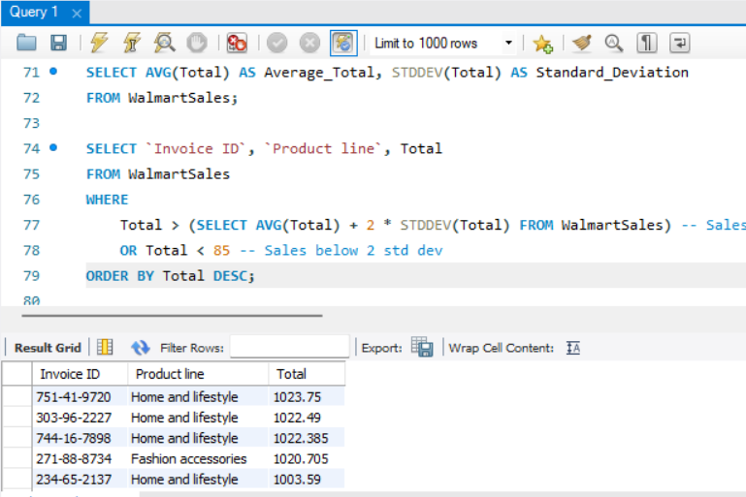
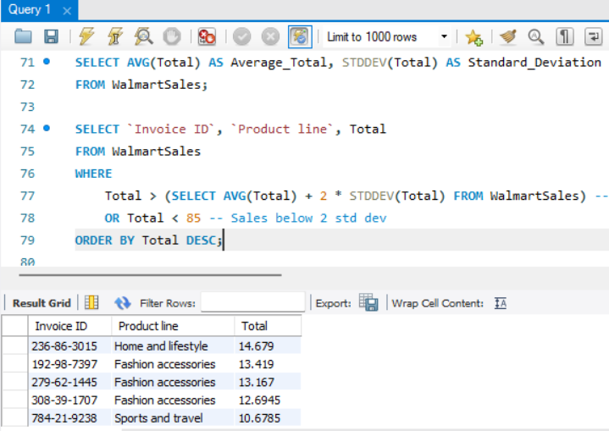
TASK 4 – SQL CODE
SELECT AVG(Total) AS Average_Total, STDDEV(Total) AS Standard_Deviation
FROM WalmartSales;
SELECT `Invoice ID`, `Product line`, Total
FROM WalmartSales
WHERE
Total > (SELECT AVG(Total) + 2 * STDDEV(Total) FROM WalmartSales) -- Sales above 2 std dev
OR Total < 85 -- Sales below 2 std dev
ORDER BY Total DESC;

Slide 11
TASK 5 - Most Popular Payment Method by City
Count Transactions by Payment Method
Calculate the Maximum Transaction Count per City
Filter for the Most Popular Payment Method

Slide 12
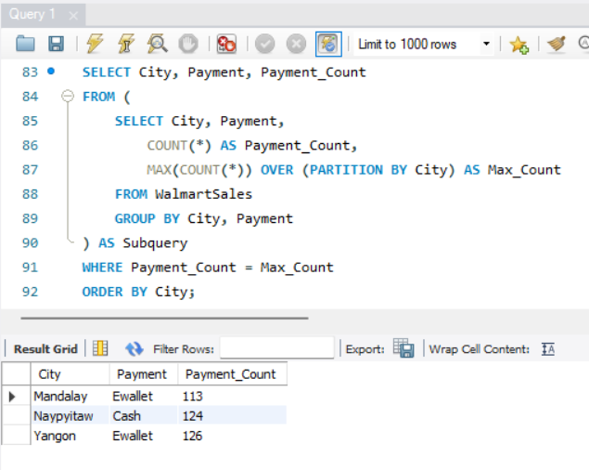
TASK 5 – SQL CODE
SELECT City,
Payment,
Payment_Count
FROM (
SELECT City,
Payment,
COUNT(*) AS Payment_Count,
MAX(COUNT(*)) OVER (PARTITION BY City) AS Max_Count
FROM WalmartSales
GROUP BY City, Payment
) AS Subquery
WHERE Payment_Count = Max_Count
ORDER BY City;

Slide 13
TASK 6 - Monthly Sales Distribution by Gender
Extract Month Name and Gender
Calculate Total Sales
Group and Order the Results

Slide 14
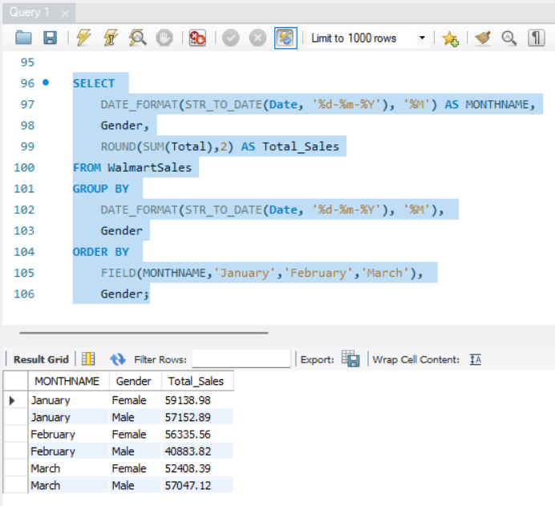
TASK 6 – SQL CODE
SELECT
DATE_FORMAT(STR_TO_DATE(Date, '%d-%m-%Y'), '%M') AS MONTHNAME,
Gender,
ROUND(SUM(Total),2) AS Total_Sales
FROM WalmartSales
GROUP BY
DATE_FORMAT(STR_TO_DATE(Date, '%d-%m-%Y'), '%M'),
Gender
ORDER BY
FIELD(MONTHNAME,'January','February','March'),
Gender;

Slide 15
TASK 7 - Best Product Line by Customer Type
Group Data and Calculate Total Sales
Subquery to Find Maximum Sales
Filter and Return Maximum Sales per Customer Type

Slide 16
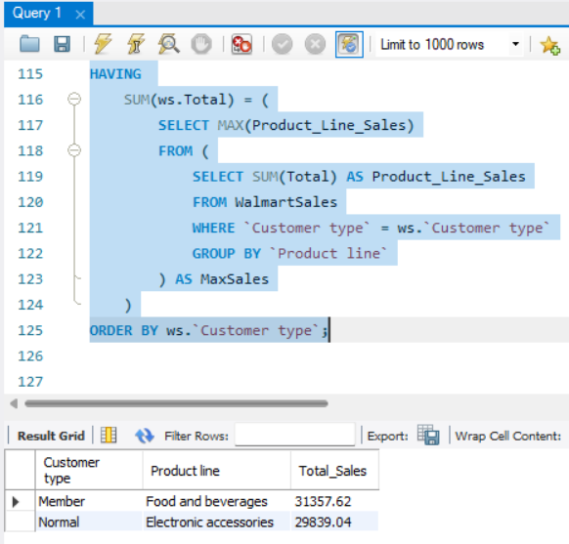
TASK 7 – SQL CODE
SELECT ws.`Customer type`,
ws.`Product line`,
ROUND(SUM(ws.Total),2) AS Total_Sales
FROM WalmartSales ws
GROUP BY ws.`Customer type`, ws.`Product line`
HAVING
SUM(ws.Total) = (
SELECT MAX(Product_Line_Sales)
FROM (
SELECT SUM(Total) AS Product_Line_Sales
FROM WalmartSales
WHERE `Customer type` = ws.`Customer type`
GROUP BY `Product line`
) AS MaxSales )
ORDER BY ws.`Customer type`;

Slide 17
TASK 8 - Identifying Repeat Customers
Getting First, Last purchase date and using Self join on dataset
Mentioning dates in Where clause for time span
Counting Invoice ID to get total repeat buys

Slide 18
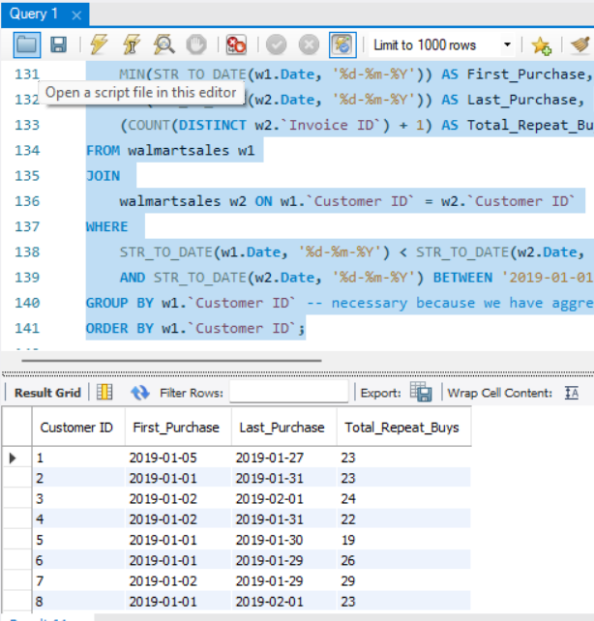
TASK 8 – SQL CODE
SELECT
w1.`Customer ID`,
MIN(STR_TO_DATE(w1.Date, '%d-%m-%Y')) AS First_Purchase,
MAX(STR_TO_DATE(w2.Date, '%d-%m-%Y')) AS Last_Purchase,
(COUNT(DISTINCT w2.`Invoice ID`) + 1) AS Total_Repeat_Buys
FROM walmartsales w1
JOIN
walmartsales w2 ON w1.`Customer ID` = w2.`Customer ID`
WHERE
STR_TO_DATE(w1.Date, '%d-%m-%Y') < STR_TO_DATE(w2.Date, '%d-%m-%Y')
AND STR_TO_DATE(w2.Date, '%d-%m-%Y') BETWEEN '2019-01-01' AND '2019-02-01'
GROUP BY w1.`Customer ID`
ORDER BY w1.`Customer ID`;

Slide 19
TASK 9 - Top 5 Customers by Sales Volume
Select Customer ID and Sum of Total for Total_Revenue
Use Limit function to get only Top 5 customers with highest revenue
Group By Customer ID and Total_Revenue in Descending order

Slide 20
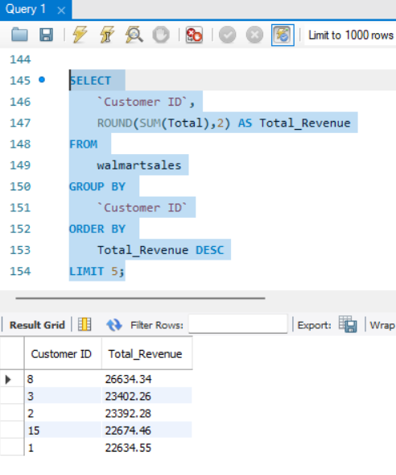
TASK 9 – SQL CODE
SELECT
`Customer ID`,
ROUND(SUM(Total),2) AS Total_Revenue
FROM
walmartsales
GROUP BY
`Customer ID`
ORDER BY
Total_Revenue DESC
LIMIT 5;

Slide 21
TASK 10 - Analyzing Sales Trends by Day of the Week
Use DAYNAME() to extract Days from the Date.
Group By Day name and Order by Total Sales DESC
Calculate Total Sales per DAYNAME and round the value to 2 decimals

Slide 22
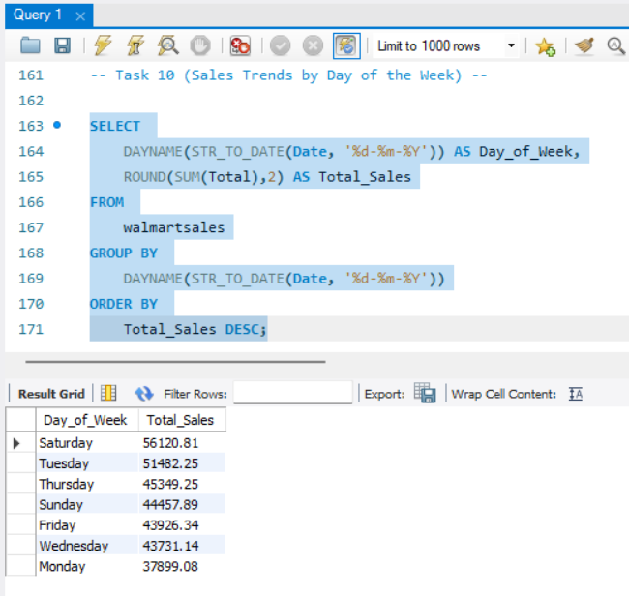
TASK 10 – SQL CODE
SELECT
DAYNAME(STR_TO_DATE(Date, '%d-%m-%Y')) AS Day_of_Week,
ROUND(SUM(Total),2) AS Total_Sales
FROM
walmartsales
GROUP BY
DAYNAME(STR_TO_DATE(Date, '%d-%m-%Y'))
ORDER BY
Total_Sales DESC;

